Slide 1
Individual Development Plans (IDP)
Kristen K. Mighty
Office of Postdoctoral Affairs
The Graduate School, Northwestern University

Slide 2
What is an IDP?
Tool designed to aid in building a career and professional development roadmap
Tailored to mentee’s skills, interests, and values.
Resource for initiating and sustaining discussions between mentees and mentors.
intended to develop mutual expectations of both mentees and mentors
Provides structure for regularly occurring (every 6-12 months) career and professional discussions with mentors
IT IS NOT meant to be a rigid compact
Tool designed to aid in building a career and professional development roadmap
Tailored to mentee’s skills, interests, and values.
Resource for initiating and sustaining discussions between mentees and mentors.
intended to develop mutual expectations of both mentees and mentors
Provides structure for regularly occurring (every 6-12 months) career and professional discussions with mentors
IT IS NOT meant to be a rigid compact
Adapted from: http://myidp.sciencecareers.org/ (Read our privacy policy/legal terms.)
Boston University Professional Development and Postdoctoral Affairs
Entering Mentoring Curriculum, National Mentoring Research Network

Slide 3
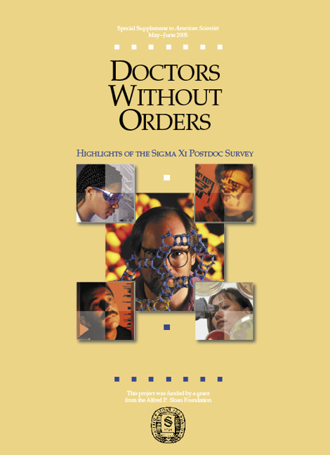
IDPs and Career Planning Work for Mentees and Mentors
Sigma Xi Survey
22,000 postdocs contacted
7600 postdocs responded
Postdocs with a written, structured plan:
More productive than those without a plan
submitted papers at a 23% higher rate
published at a 30% higher rate
submitted grants at a 25% higher rate
Fewer conflicts with PI
More satisfied
http://www.sigmaxi.org/docs/default-source/Programs-Documents/Critical-Issues-in-Science/postdoc-survey/highlights

Slide 4
IDP: Discussion Tool & Ongoing Process Driven by Mentee
Assess
Skills
Develop
Desired Skills
Explore
Careers
myIDP tool
NPA
OPA
NPA
myIDP tool
VPhD
TGS, OPA events
prof. societies
SMARTS guide
OPA
myIDP tool
Adapted from: http://myidp.sciencecareers.org/ (Read our privacy policy/legal terms.)
Boston University Professional Development and Postdoctoral Affairs
Entering Mentoring Curriculum, National Mentoring Research Network

Slide 5
IDP: Resources for Mentors
1. SKILLS ASSESSMENT – what skills do I currently have?
2. CAREER ASPIRATIONS – what career pathways interest me? What do I like to do and what do I value about my work environment?
3. DESIRED SKILLS – setting goals for the skills I want.
4. PROFESSIONAL DEVELOPMENT – what support can I take advantage of?
Adapted from: http://myidp.sciencecareers.org/ (Read our privacy policy/legal terms.)
Boston University Professional Development and Postdoctoral Affairs
Entering Mentoring Curriculum, National Mentoring Research Network

Slide 6
IDP: Tips for Mentors
Keep discussions timely & relevant:
Start early, re-visit every 6-12 months
Coincide with pre-existing big-picture milestones & discussions
Maintain flexibility as needed (format/process) while providing accountability for working towards goals
Encourage trainee to present IDP to others (co-mentors, peers)
Connect trainees to resources throughout the process
OPA: http://www.tgs.northwestern.edu/resources-for/postdocs/index.html
myIDP: http://myidp.sciencecareers.org/
NPA: http://www.nationalpostdoc.org/

